Slide 1
AI – PPM Integration (RT & Batch) DRAFT
Part 1 of 2 for AI CCV Prospective payment solution
Restricted

Slide 2






CV RT (Real time) & batch Integration (PPM) technologies
Data Robot: Serving the models
Scala: transformations / drools execution / model rest calls / post model transformations
Docker Containers: Containerization of AI/ML API Application
OpenShift: container orchestration, auto scaling, Load balancing, High Availability
Hadoop: Long term storage for tracking, reporting, future modeling

Slide 3
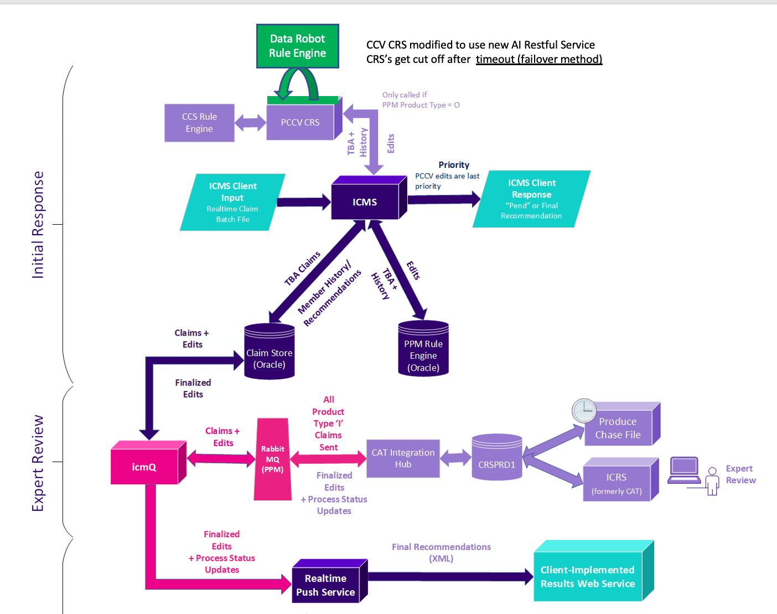
Process Flow Diagram
Focus Area

Slide 4

AI Internal Architecture (focused)
AI – PPM Rule Engine
Request / response shown on slides 8/9
Route
Load Balancer
Auto Scaler
CRS callable Rule Service
AI – PPM-FL / MM Application
PVC
HDFS

Slide 5
Requirements (Scala – AI Feature Engineering)
Have a total turn around time of 1.25 seconds or lower (including model)
Per claim
Accept >1 records in 1 payload. Each record (not the batch) should adhere to the above time
Transform the incoming data set (slide 7) into multiple feature sets for applicable model(s)
Score multiple models against a single claim (many to 1)
Combine multiple scores into a single ‘pay or pend’ response based upon drools set configuration
Ex.
Model 1 score > .83 (priority 1) PEND
Model 1 Score < .31 and Model 2 score >.91 = PAY
Format outputted decision into return format (slide 8)
Package jar into a docker container that exposes port for scoring
Be config driven (for determination rules & model 2 claim mappings)

Slide 6
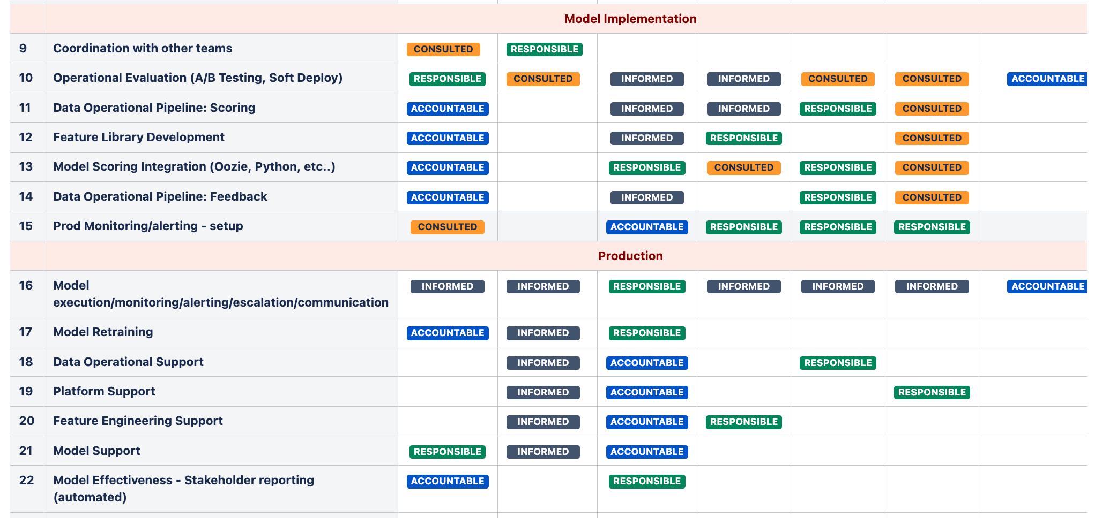
Ownership (All Other Teams)
Follow typical ownership of processes defined on RACI Diagram
https://confluence2.cotiviti.com/display/MLSA/AI+-+Responsibility+Assignment+Matrix

Slide 7
Incoming dataset Format & Example
Schema link: https://confluence2.cotiviti.com/display/CCVRD/PCCV+Realtime+Selection+Engine+-+Environments+and+deployment
Ex. Request:
https://confluence2.cotiviti.com/pages/viewpage.action?pageId=293159372

Slide 8
Outgoing dataset Format & Example
Ex. Response & format
https://confluence2.cotiviti.com/display/CCVRD/PCCV+Selection+Engine+-+Request+and+Response
Notable Codes in Outgoing Schema
Reason Codes:
AUPND - Selected for Audit (Audit Pending)
DENY - Denied
PAY - Not Selected
Review:
INTERNAL - Internal Review/Audit
NONE - No Review
mr: Is Medical Record required

Slide 9
AI – DCS Integration (RT & Batch)
Part 2 of 2 for AI CCV Prospective payment solution
Restricted

Slide 10
PCCV – Post Pay Batch (Non PPM) – Technologies
To be filled in via ML Ops / Team Jedi

Slide 11
PCCV – Post Pay Batch (Non PPM) – Process Flow
To be filled in via ML Ops / Team Jedi

Slide 12
AI Internal Process (focused)
To be filled in via ML Ops / Team Jedi

